Slide 1
Examining the viscera and judgment
meat hygiene

Slide 2
Introduction
Routine post-mortem examination or inspection is based on the examination of heads and their lymph nodes, thoracic and abdominal viscera and their lymph nodes, and the exposed parts of thecarcass.
The inspection is made of organs and body lymph nodes, when significant abnormalities are observed during routine examination.

Slide 3
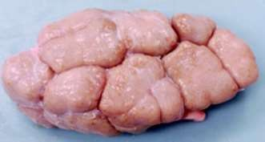
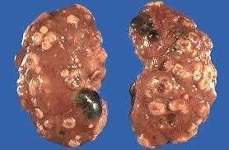
Inspection of kidneys
Kidneys normally remain attached to the carcass for inspection, which is conducted by visual inspection and palpation.
Only if any abnormality is detected should the renal lymph nodes be cut open to detect nephritis.

Slide 4
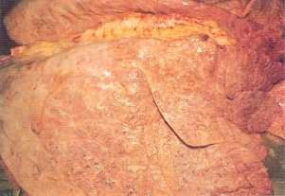
Inspection of lungs
Visual inspection for pneumonia, cysts (e.g. hydatid), abscesses, tumors, etc.
palpation to detect any of the above within deeper tissue.
Incision and examination of bronchial,
mediastinal pairs of lymph nodes (note: tuberculosis can be diagnosed in these lymph nodes).
Incision to open trachea and lower and foreign contents (food, parasites, blood, etc.) or partially swallowed food.

Slide 5
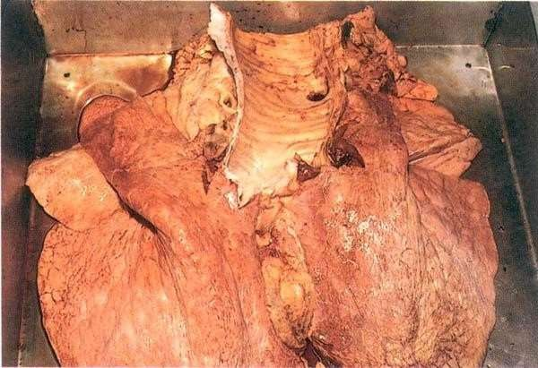
Lung inspection in buffalo - Open trachea and incised bronchial and mediastinal lymph nodes.

Slide 6
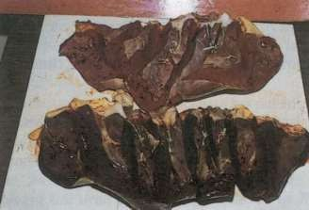
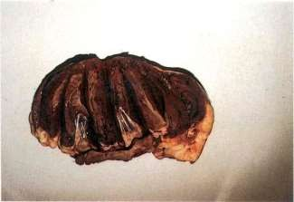
Inspection of heart
Visual inspection for pericarditis;
opening of pericardial sac to examine for abnormal amount or appearance of the liquid; and incisions to open all chambers to examine for endocarditis, and for cysticercosis cysts in the septum.

Slide 7
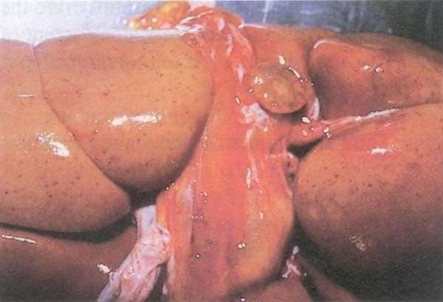
Serous atrophy of renal fat. Note petechial hemorrhages, seen frequently in septicemic diseases.

Slide 8
Inspection of diaphragm
If cysticercosis has been found in the cheek muscles or in the heart, the diaphragm must also be inspected.
Genital organs
These are visually inspected and palpated; they are incised only if any abnormality is detected.

Slide 9
Inspection of liver
This organ is particularly important as a general indicator of animal health, as many abnormalities occur in the liver of sickanimals:
• visual examination for degenerations, dystrophies, cysts (e.g. hydatid), abscesses, tumors, tuberculous lesions;
• palpation to detect any of the above in deeper tissue, palpation of the hepatic lymph node(and its incision if any abnormalities found); and
• incisions to open the bile ducts (along the main ducts and across the caudal lobe) to examine for liver disease

Slide 10
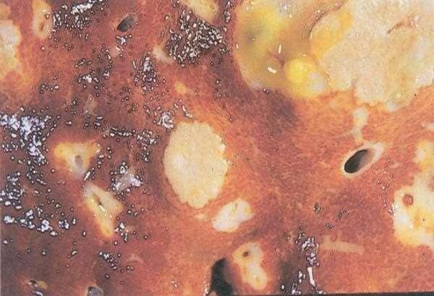
Liver abscesses caused by
Fusobacterium necrophorum.

Slide 11
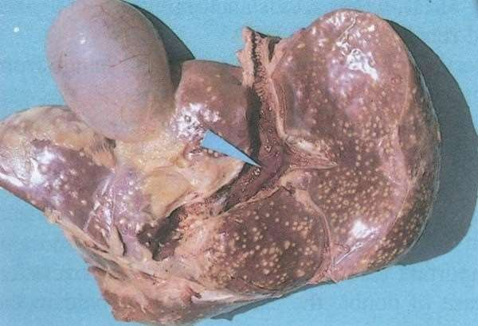
Multiple abscesses in the calf liver as a result of an umbilical infection; carcass with such condition should be condemned.

Slide 12
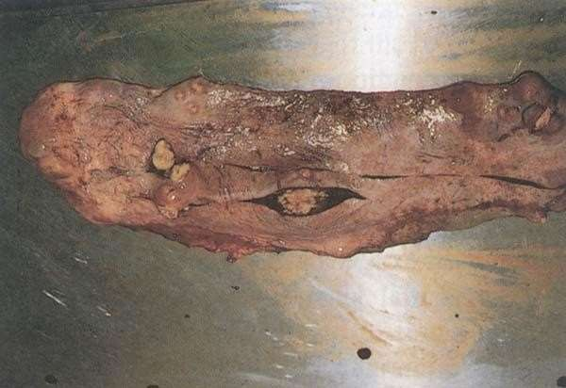
Spleen The spleen must not be removed or incised prior to PM examination.
Secondary abscesses in the spleen of an aged cow.

Slide 13
Inspection of alimentary tract
Alimentary tract contents are usually inspected whilst placed intrays, and include esophagus, rumen and large and smallintestines:
• visual inspection of rumen and intestines for
enteritis, etc.: salmonellosis and Johnes’ disease both cause redness of the enteric tract, so may be detected by visual inspection;
• palpation of the mesenteric lymph nodes – ifany abnormality is detected, these lymph nodes may be incised for further inspection; and
• palpation of oesophagus for parasitic cysts, etc.

Slide 14
Udder
The udder is examined, visually and by palpation, after it has been separated from the carcass.
Conduct a visual inspection and palpation. Mastitis is frequently caused by zoonotic agents, so care must be taken to avoid milk secretion and spillage, with possible contamination of other edible tissues. Also, tuberculous lesions may be found in the udder.

Slide 15
Examples for Judgement
Some common examples include localized abscesses hydatid cyst in liver
The affected parts must be removed and condemned (appropriately disposed of), while the remaining healthy normal tissues can be fit for humanconsumption.
liver is unfit for esthetical reasons, although the disease is not transmitted to humans.
Positive identification of the viscera must be maintained until a disposition has been made.

